Slide 1
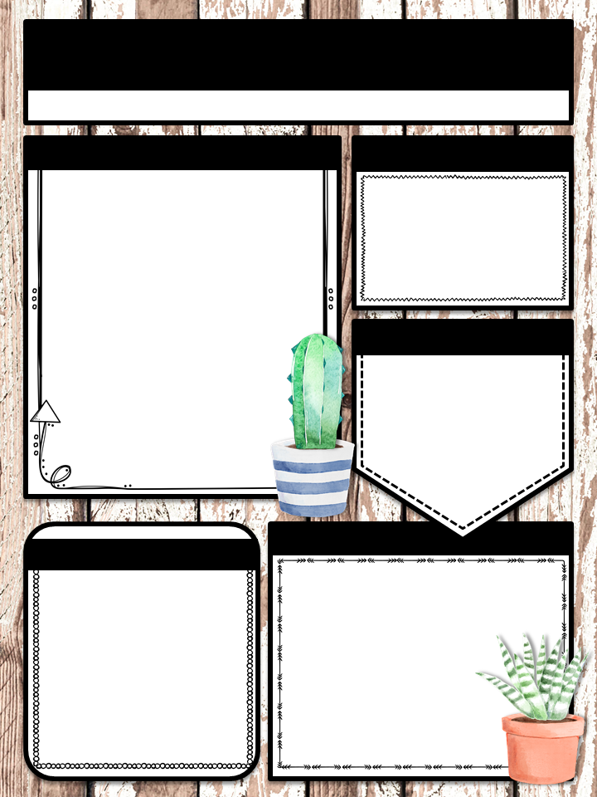
Mrs. Rumbaugh’s Classroom News
Week of December 2-6 trumbaugh.weebly.com
Skills/Tests
Communication
Subject | Skill | Quiz/Test
Math | SOL 4.2: Fractions | Division Timed Quiz Friday Fractions Quiz this week
Reading | Unit 3: Inferencing | Quiz Friday
VA Studies | VS 3 a, b, c, f, g Jamestown and The Virginia Colony | Quiz this week
Writing | Descriptive Writing
Tabitha.Rumbaugh@cpschools.com
757-421-7080
Text @rumbaugh1 to 81010 to join our text reminders!
Birthdays
Tyler 12/17
Liam 12/24
**Please note that quizzes and tests are subject to change!
Upcoming Events
Reminders
December 14 – Breakfast with Santa
December 20th – Christmas Party
December 23-January 1 – Winter Break
January 2 – Students Return
Our basket for Breakfast with Santa is a “Book Nook” theme. Donations of new books and/or Barnes and Nobles Gift Cards will be needed by December 11th.

